Slide 1
What HR Pros Should Know About EMS
Massachusetts Ambulance Association
Human Resources Summit December 5, 2018

Slide 2
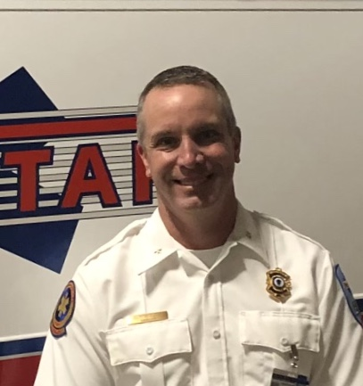
Rick A. Barry Medstar EMS, Chair-MAA Operations Group
rbarry@medstarma.com
(978)441-2758

Slide 3
1. We get hurt a lot…
EMS workers more likely to be injured at work than general workforce
Injured EMS workers out of work 3X longer than general workforce
NIOSH study found 22,000 EMS workers treated at Emergency Departments per year for work related incidents (does not include treated elsewhere (walk in clinic) or self treated)
Most common injury: Back/Neck strain
Most common injured employee: Full time, less than 10 years
2/3 injured male, 1/3 injured female. This reflects the makeup of EMS workers, suggesting males and females are at same risk for injury
Source: Emergency Medical Services Workers; How Employers can Prevent Injuries and Exposures -NIOSH

Slide 4
Common Injuries

Slide 5
Cost of a Back Strain
Direct cost (Workmen's Compensation Premiums, Case Management, Medical Costs for Surgury/Rehabilitation/Medication, and other ancillary costs
Indirect Cost: Loss of productivity, overtime for coverage of injured employee, potential OSHA fines, Attorney fees
Average cost of a back injury greater than $10,000 in direct costs, and up to $100,000 indirect costs
Source: What does a workplace injury cost: DORN Companies

Slide 6
Suggestions?
Work with Operations and front line employees to understand the factors leading to injuries (equipment, training)
Prehire physical exams with lifting ability test
Light duty assignments for injured employees
Wellness programs (EMS Yoga)

Slide 7
2. Sexual Harassment
2010 study by Society for Human Resource Management found 1/3 of companies had a sexual harassment complaint to deal with in previous two years
EEOC received 11,300 cases of sexual harassment in 2011
1400 settled for total of $52 million
“If a lawsuit is brought forward, the company is going to smoke a $100,000 bill in legal fees and investigations even if you win,” says Peter Stark, a consultant who specialized in helping companies prevent sexual harassment.
-”The High Cost of Sexual Harrassment”
The Fiscal Times, August 2013

Slide 8
EMS and Sexual Harassment
1999 Survey by Linda Honeycutt reports 69% of female EMS workers had felt sexually harassed in the workplace
Harassment included supervisors, coworkers and patients
1. Honeycutt L. Girl talk: An EMS educator reports her findings on the state of women in the industry. JEMS. 1999;24(1):50–53

Slide 9
No joking matter
Nicole Mittendorff Fairfax County Fire Department
Complained of frequent requests for sexual favors by coworkers, told “it’s a man’s job, what do you want?”
Online chat forum discussed female fighters by name and referenced their bodies and sexuality
Committed suicide age 31

Slide 10
Complications in dealing with sexual harassment in EMS
Younger workforce
Dynamics of coworker relationships
Largely unsupervised
Interactions outside of agency (patients, hospital staff, fire and police personnel)

Slide 11
Suggestions?
Fostering a “zero tolerance” policy
Sexual Harassment training beyond “CYA”
Reporting System
Training for management
Specific policy for reaction by management for complaints

Slide 12
3. We sometimes die at work

Slide 13
Safer than Police and Fire Departments?
EMS: 12.7 per 100,000
Police: 14.2 per 100,000
Fire: 16.5 per 100,000
Source: Department of Labor Census of Fatal Occupational Injuries 1992-1997
Line of Duty Deaths per 100,000

Slide 14
How we lose EMS providers:
67-Ground Ambulance Crash
19-Air Ambulance Crash
13-Medical
10-Violence
5- Other
Total 114
Occupational fatalities in EMS, a hidden crisis; Annals of Emergency Medicine 40(6):625-32 · January 2003

Slide 15
MVA-Biggest threat

Slide 16
4. Mental Health

Slide 17
Suicide cause of 1 in 20 deaths of EMS professionals in Arizona
University of Arizona College of Medicine Study
Reviewed all deaths in Arizona as well as Arizona resident deaths outside of country 2009-2015
Separated to “EMS” and “non EMS” based on profession listed on death certificate; Firefighter included with EMS
Approx 350,000 non EMT’s, 1200 EMT’s
5.2 % of EMT’s, 2.2% of non EMT’s listed as suicide
-Prehospital Emergency Care. (DOI: 10.1080/10903127.2018.1514090)
https://www.ems1.com/paramedic-chief/articles/392878048-research-analysis-more-than-1-in-20-emt-deaths-are-due-to-suicide/

Slide 18
Losses beyond suicide related to mental health
Providers changing profession due to “burn out”
Increased sick calls
Decrease in patient/customer satisfaction
Cultural damage to agency from “bad apple”

Slide 19
Suggestions?
Active visible promotion of EAPs
Code Green Campaign
Lifeworks (American Ambulance Association EAP)
Revivingresponders.com
Agency EAP/internal resources

Slide 20
Why we’re here…
This is probably the business/HR/marketing degree of the person who represents your department 16hrs a day and 48hrs on weekends.

Slide 21
Thanks for having me! -Rick

